Slide 1


Senior Data Analyst Home Assignment
Idan Haim - Nov 2024

Slide 2


Agenda
Intro
What conversations are about?
Conversation success rate
KPI definition
Conclusion
Appendix

Slide 3

Intro
or, what are we going to talk about?
Notes:
OK so lets review some of our key product highlights

Slide 4

Intro
The goal of this analysis is to examine conversation topics made with the chat assistant, understand how successful they were, and recommend on KPI's for ongoing measurement of this topic.
Although there are many paths this research can take, it was limited to an overall overview of chat prompts and the assistant's ability to address them. The intention is to supply the team with short, concise, actionable insights we can act upon.
In order to understand chat conversations topics, I looked at user and bot utterance text. The idea was to follow the natural conversation flow in both a quantitative and qualitative way.

Slide 5
Conversation Topics
or, what people are talking about
Notes:
OK so lets review some of our key product highlights

Slide 6
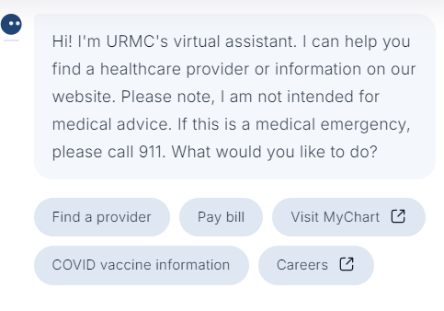

Conversation Topics
what people are talking about
Chat Assistant Interface
Before diving into the conversations themselves, it is important to remember what the chat interface looks like. While opening The chat window for a new conversation, the user is already presented with several options.
Chat Assistant Options:
Image
Finding a Provider - locating and scheduling physician appointments
Pay Bill - resolving payment issues
COVID Vaccination Information
Visit MyChart - link to the user's private medical portal
Careers - intended for non-patient users of the portal

Slide 7
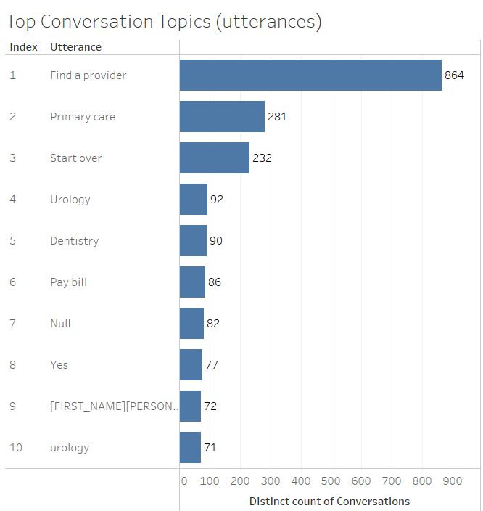
Conversation Topics
what people are talking about
Initial Overview
Looking at user utterances, unfiltered, we see that indeed “Finding a provider” is the topmost discussed topic (with 37.98% of all user utterances sampled).
Sidenote
That said, the second and third most common topics -"Primary care" and "Start Over"- reminds us that conversations tend to evolve, shift and touch more than one topic, and that there is a need to separate between the start and the body of the conversation.

Slide 8
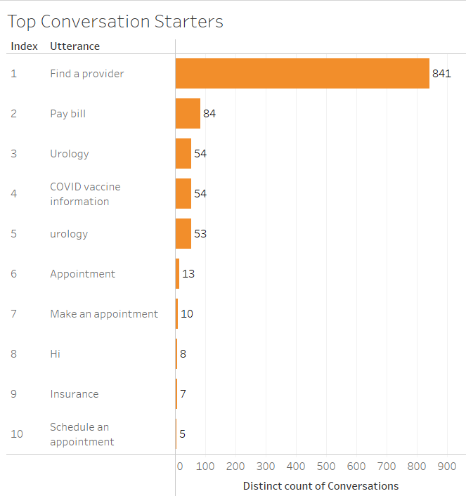
Conversation Topics
what people are talking about
Conversation Starters
When filtering user utterances by event position (i.e. what was the first thing a user wrote in the chat) we see that “Finding a provider” is still the topmost topic, but that this is not the case with the rest of the five presuggested topics.
“Pay bill” and "COVID Vaccination Information" still appear in second and fourth positions, respectively, but the rest of the conversations seems to revolve around two 'unmentioned' topics: Urology and Appointments.

Slide 9
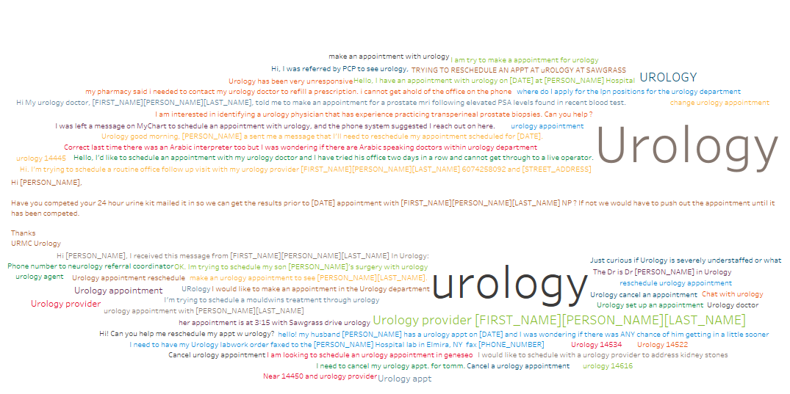
Conversation Topics
Since we are dealing with free text here, it is important to remember that utterances over the same topic can come in various forms (and spelling manners).
Image or graph

Slide 10
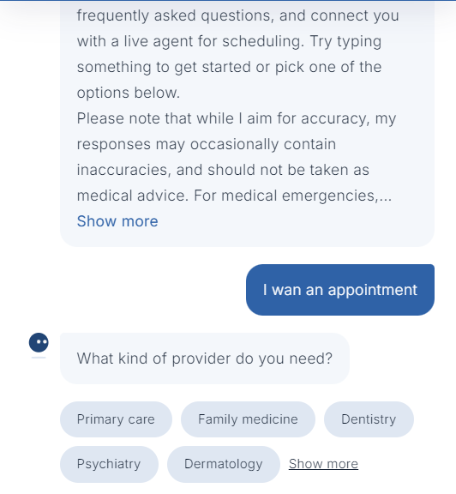
Conversation Topics
what people are talking about
Who starts a conversation like this?
In practice, both "Urology" and "Appointments" could be reached by selecting the “Finding a provider” option, but apparently this flow is not clear to some of the users.
Intuitive conversation
It should be said that the assistant logic still works as intended in routing the users to their desired action, but it is interesting why this happens. Would different naming conventions or selection options would have created a more intuitive user interaction?
We can further explain this in our next section.

Slide 11
Conversation Success Rate
How do we measure success
Notes:
OK so lets review some of our key product highlights

Slide 12
Conversation success rate
How do we measure success
What is success
When deploying a conversation assistant, the goal of both Hyro and the client is to improve customer interaction. We want to make sure users find what they need. Since we cannot assume that all questions are answered the moment we deploy an assistant, it should be tested.

Slide 13
Conversation success rate
How do we measure success
Defining success
When asking "how many conversations were successful", we first need to agree on what is our definition of a successful conversation. In the absence of the ability to ask the users (and trust their answers), there are two plausible ways to determine that:
The conversation was contained by the assistant and no external involvement was required.
The conversation yielded positive feedback that the user answers have been met.
Both definitions are lacking: the first is prone to false positives, while the latter to false negatives. But, we will assume adequacy for now and explore our hypotheses.

Slide 14
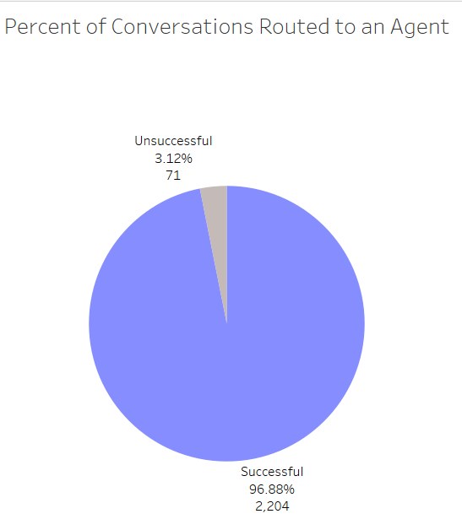
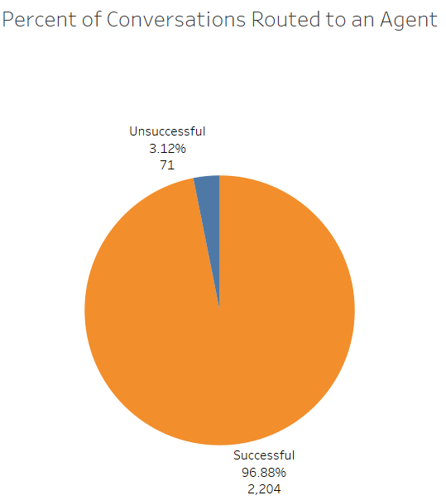
Conversation success rate
How do we measure success
Conversation Containment
In order to examine conversation containment, conversations with bot utterances containing messages about "connection to a live agent" were searched. Those were considered as 'unsuccessful' conversations. The percentage of 'successful' conversation by this measurement is 96.88%. Only 3.12% of conversations required a live agent.

Slide 15
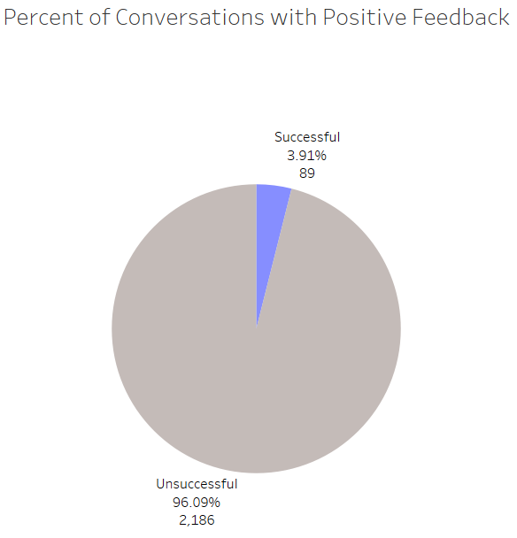
Conversation success rate
How do we measure success
Positive Feedback
In order to examine positive feedback, conversations with user utterances of "Thank you" and bot utterances of "Have a great day" were searched. This calculation is far looser than our previous one and relies heavily on social etiquette. That said, it is a valid approximation of an unmeasurable metric of "how satisfied are chat users?".
The percentage of 'successful' conversation by this measurement is 3.91%; an almost mirror image to our previous, live agent, one.

Slide 16
Conversation success rate
How do we measure success
Which is more successful
These results show us the problem with narrow definitions of 'success' and how the way we choose to measure it might influence our end result. That said, we can still use our findings.
True, conversation containment does not necessarily mean the user found what they were looking for, and the absence of positive feedback does not necessarily mean the conversation was unsuccessful, but their existence hint at certain user behaviors we can use to deduce feeling. The trick is to complement them with additional, weighted, metrics that will help us come to our desired standard.
So, what other measurement should be in place? That is a good segway to our next section.
Success by Measure A
Success by Measure B

Slide 17
KPI definition
Agreeing on how to measure success
Notes:
OK so lets review some of our key product highlights

Slide 18





KPI definition
While terms like 'successful' and 'unsuccessful' are somewhat loose in their definition, we can break their intention down to more manageable metrics:
Resolution Rate
Response Accuracy
The percentage of user queries ending in chat directed action (appointment booking, payment, etc.).
The percentage of relevant recommendations
User Satisfaction
Containment
The calculated overall rating of chatbot interaction
The percentage of queries resolved without human intervention
Response Time
The average time to provide initial user response (first suggestion of chat directed action)

Slide 19
KPI definition
Agreeing on how to measure success
While some performance indicators (Resolution rate, Response time, Containment) could be answered with the existing conversation information, others (User satisfaction, Response accuracy) requires additional information to be generated.
Both User satisfaction and Response accuracy could be partially inferred by user interaction and engagement, but should be complemented by user prompted feedback (e.g. Thumbs up/down to recommendations; overall satisfaction score).

Slide 20
KPI definition
Agreeing on how to measure success
What KPIs should be shared with clients
Well, it depends. These 'success' metrics should be available to both Hyro and the client, but some adjustment should be made in their presentation.
For example: while Response Time should be presented internally in Hyro as an absolute number, to the client it is best presented as percentage (%) of improvement from a human representative, or overall support hours saved.
So, what metrics should be presented to the client? It depends on the client needs.
The goal is to give the clients the insight they are looking for, not (necessarily) the underlying data.

Slide 21
Conclusion & Recommendations
What did we talk about and what’s next
Notes:
OK so lets review some of our key product highlights

Slide 22

Conclusion
What did we talk about
To wrap things up
Chat assistant conversations were examined for their main topics and conversation starters.
Two approaches were examined in testing conversation success rate:
Containment - resolution without human interaction
Positive Feedback - inferred user satisfaction from in-chat indicators
Additional performance indicators were suggested to better quantify 'success' in the future

Slide 23




Recommendations
Rounding up our analysis and conclusion are some follow-up actions that could be taken. These should be regarded as recommendation and should be further flushed out by the team.
Business
Product
Development
Company agreed 'success' metrics and definitions should be put in place.
User prompted feedback should be incorporated in chat
Data tagging of user and bot utterances should be added to assist in future conversation analysis.
Chat Action naming conventions should be tested
Chat options optimization should be tested

Slide 24
Appendix
Notes:
OK so lets review some of our key product highlights

Slide 25
Appendix
Method
In this analysis, I used the following tools and practices:
Python - to load and transform the supplied data. CSV
Tableau - for data roaming, analysis and data presentation
PostgreSQL - to solve the additional query request
In order to not burden or clutter my submission, all associated notebooks, queries, csv extractions and twbx files are available in this git repo.
In my approach to this task, I tried to tell the most concise and coherent story, and to come back with actionable insights if possible. No attempt was made for flashy graphics, in-depth clustering analysis, or a comprehensive list of all measurable metrics. Just one story.
If you wish to see additional insights, not included in this presentation, put me on your payroll and add it to my backlog :)

Slide 26
Thank you!

